Slide 1
DSC 640 Line and Step Charts
By Jesse Zamora

Slide 2
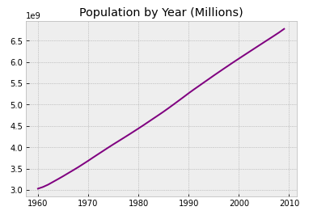
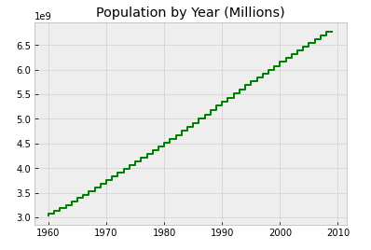
Python Charts

Slide 3
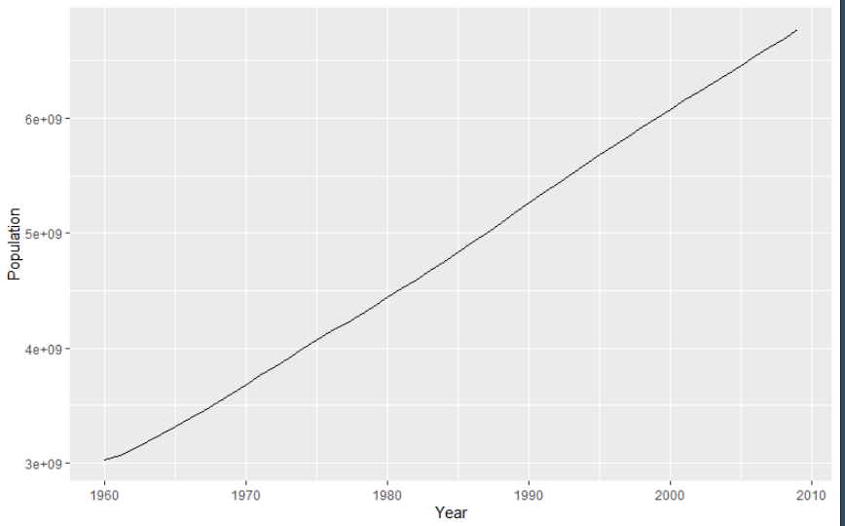
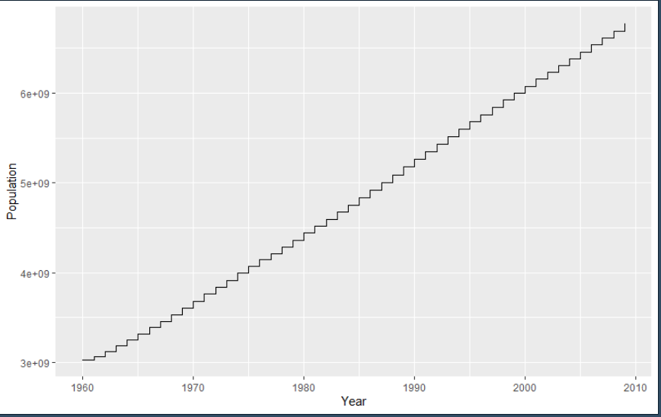
R Studio Charts

Slide 4
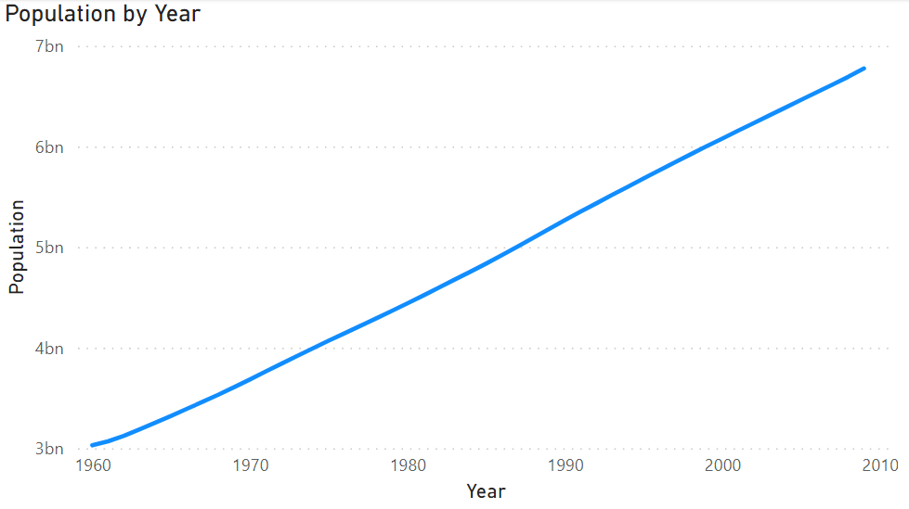
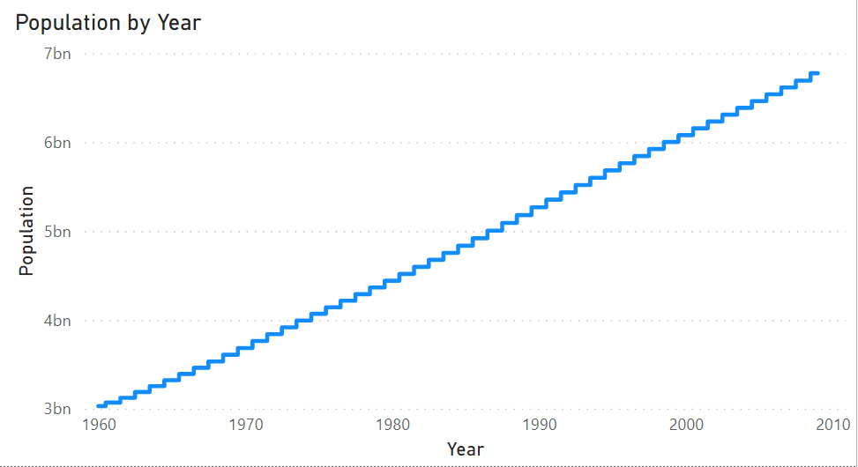
Power BI Charts

Slide 5
Code for Python and R Studio
https://github.com/JZamora1108/DSC-640/blob/main/DSC%20640%20Line%20and%20Step%20Charts.ipynb
https://github.com/JZamora1108/DSC-640/blob/main/DSC%20640%20R%20Studio%20Line%20and%20Step%20Charts.R

